Slide 1

Welcome to...
Year 6

Slide 2

Year 6
The members of staff that will be working with your children this year are:
Miss Wolfe
Mrs Stronge (Friday mornings)
Mr Knuppel (mornings)
Ms Gonzales (all day)
Miss Brown (afternoons)

Slide 3
Routines
Water Bottles
Please could you send your child to school with a named water bottle containing WATER only. There is a school one that they can use, if necessary.
Snacks
Should you wish your child to have a snack at morning break please send them with their own healthy snack – fruit or veg. However please remember that nuts should not be sent in as a snack.
Equipment
In KS2 we provide all equipment such as pencils, rulers, calculators etc so children do not need to bring pencil cases to school.

Slide 4
Equipment
PE
Please could you make sure that your child has their PE/swimming kit on our PE days. Our days are Monday and Thursday.
Children should have a white T-shirt, black/navy shorts for indoor PE, as well as black/navy jogging bottoms, school jumper/fleece and suitable trainers for outdoor PE. Please inform us, in writing, if your child is unfit to participate in PE.
They are not allowed to wear earrings in PE.

Slide 5
Behaviour
It is expected that the children in Year 6 will set a high standard of good behaviour.
We follow the school’s Behaviour System.
The children are expected to try their best in all aspects of school life, individually and in a team. As the oldest children in school, there are a large number of opportunities for them to make a significant, positive contribution to school life. Children are asked to apply for a range of jobs and responsibilities and are expected to set a good example for younger children and all of Year 6 will have a Reception reading buddy.

Slide 6
SATs
These are happening the week beginning 11th May 2026.
There are 3 maths papers – arithmetic and 2 reasoning papers.
There is 1 reading paper.
There is 1 grammar, punctuation and spelling paper.
Writing is done within class activities and in the last month before SATs there will be LOTS of writing which could then be moderated.

Slide 7
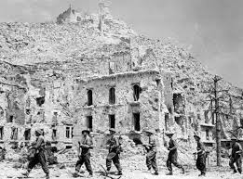
Curriculum
Topics
Over the year we will have different topics starting with
AUTUMN – The World at War

Slide 8
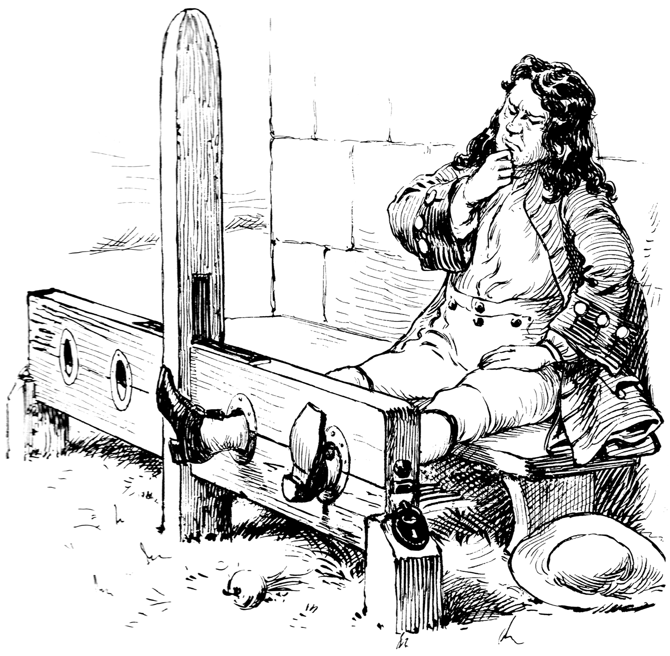
Curriculum
Topics
Over the year we will have different topics SPRING – Crime and Punishment

Slide 9
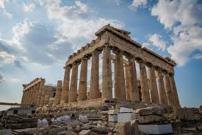
Curriculum
Topics
Over the year we will have different topics SUMMER – Ancient Greece

Slide 10
Reading
Keep at the daily reading – either by the children reading on their own or reading to you/you reading to them. Talk together about the books, the characters, the storylines and encourage him/her to express their own opinions about them.
Children need to get used to reading non-fiction texts as well as stories. Try to encourage children to read texts associated with events or interests that are meaningful to them; for example, if they like football, read through a match programme or a newspaper report with them.

Slide 11
Reading
When asking your child questions about what they have been reading, think about inference (reading between the lines) and deduction (reading beyond the lines). An example of an inference question is: 'Pick out two phrases that tell us the bear is angry with Goldilocks.' An example of a deduction question is: 'How do you think Goldilocks might have felt as she ran away?‘
We are using reading records again this year.

Slide 12
Homework
Weekly individual English tasks homework activities will be put on Google Classroom on Mondays.
This needs to be handed in by the following Monday morning. This is to begin to prepare the children for the homework expectations they will experience in secondary school. We encourage parental involvement in homework tasks so please do not hesitate to come and ask for advice or for further information.
Daily reading of at least 10 minutes.
Times table rocks stars 15 minutes 3 times a week.
Spelling shed 15 minutes 3 times a week.
An optional French homework.

Slide 13
Walking home
Children can walk home on their own once I have received a letter/email stating that they can do this.
If this is only going to happen on particular days or there is an exception, please can you inform me in writing.

Slide 14
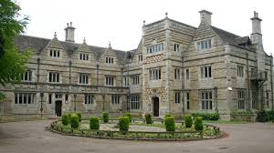
PGL
This is happening from 1st June – 3rd June at PGL, Claythorpe Court, Lincs.

