Slide 1
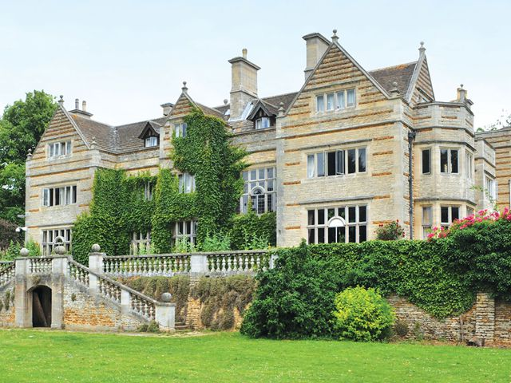
YEAR 6
RESIDENTIAL VISIT 1st – 3rd June 2026
PGL – Caythorpe Court, Linc

Slide 2
AIMS
Reasons for the visit
Organisation – staffing / accommodation etc
Activities
Health and safety / medicines
Spending Money
Kit list
Questions

Slide 3
The reasons for the visit:
To gain confidence and courage tackling new experiences
To experience the emotional response to being away from home
To recognise the organisational responsibilities of being away from home
To appreciate their own values and characteristics
To recognise the place of the individual in team and group activities

Slide 4

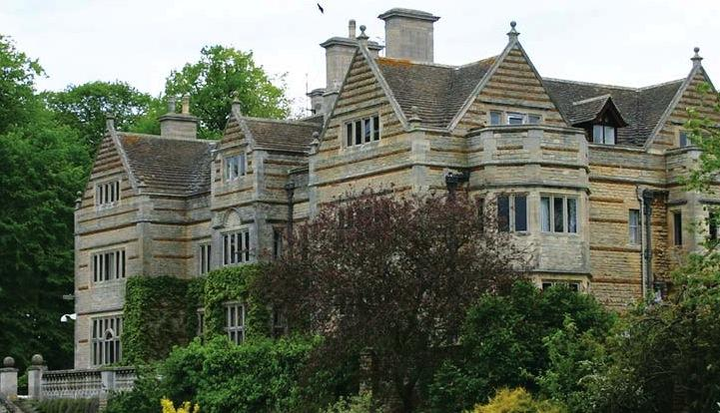
Caythorpe Court
Lincolnshire
Notes:
4

Slide 5
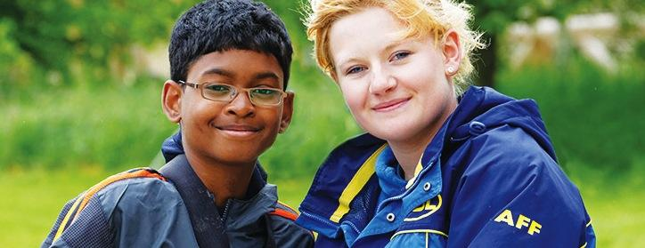




Welcome to PGL
The UK’s largest provider of outdoor education for young people
Over 55 years’ experience
Fully risk assessed
LOtC Quality Badge holder
Founding member of BAPA
ABTA bonded
Notes:
5
PGL provides a wide range of inspiring residential adventure and educational courses for more than 5,000 groups every year
All PGL centres and activities are risk assessed to comply with legal requirements and best practice. Risk assessments are available by request and on the PGL website
Centres are subject to the Adventure Activities Licensing Authority regulations (AALA) where appropriate
ABTA (Association of British Travel Agents) bonded means your money is protected
BAPA – British Activity Providers Association. Responsible for establishing operating guidelines for the activity holiday industry
Through the Learning Outside the Classroom Quality Badge Programme you can be confident that recognised providers fulfil all the necessary criteria as laid down by the DfE, thereby better enabling Party Leaders to manage visits safely, efficiently and beneficially

Slide 6
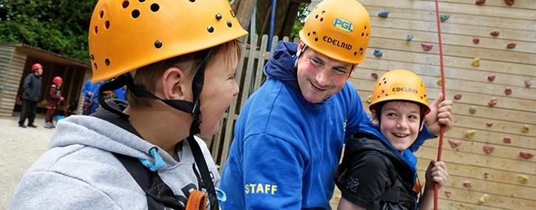
The PGL difference
Dedicated PGL ‘Groupie’ to provide support throughout stay
Tailor-made programmes
All accommodation, food, activities and instruction included
Free evening entertainment
24 hour support from centre team
Notes:
6
Each group will have a PGL Groupie who will look after guests for the duration of their stay.
All accommodation, food, equipment and instruction is included in the price of the trip.
Activities are chosen to suit the requirements of the group
4 x 1 ½ hour activity sessions every day
A full evening entertainment programme run by PGL staff includes discos, talent shows and quizzes

Slide 7
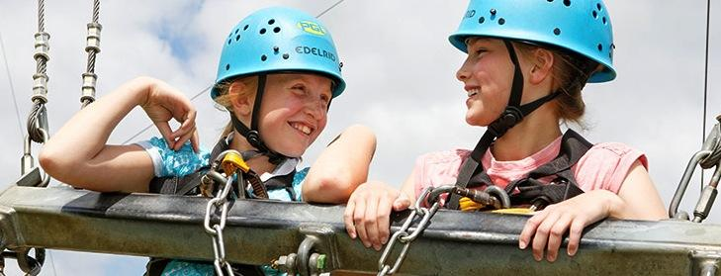
Multi-Activity
4 action-packed adventure activity sessions per day
Evening entertainment
Great for personal development & confidence building
Increases motivation & appetite for learning
Notes:
7
Benefits of a multi-activity course include:
- improved self confidence
- improved team-building skills
- better peer group relationships
- raised self esteem
- increased motivation.

Slide 8
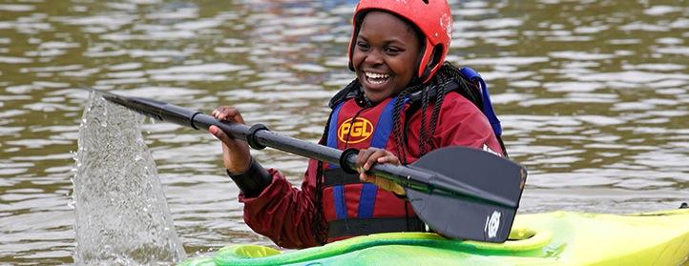
Adventure activities
  Abseiling
  Zip Wire
  Archery
  Problem Solving
  Rifle Shooting
  Survivor
  Raft Building
  All Aboard
Rifle Shooting
Sensory Trail
Sports and Team Games
Survivor
Notes:
8
The activities shown offer individual as well as team challenges
Activities are designed to encourage new skills and develop existing ones
Specific activities can be requested (though not guaranteed) and the programme is discussed on arrival at the centre

Slide 9
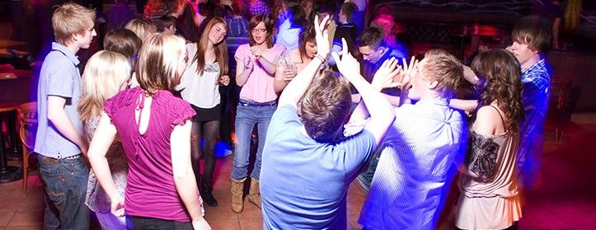
Evening entertainment
Disc Golf
Archery Tag
Notes:
9

Slide 10
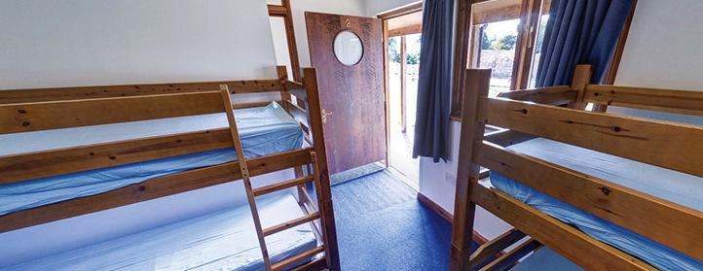

Accommodation
Single occupancy blocks – en suite rooms sleep 4-6
Accommodation for Caythorpe Court can be viewed in the 360 virtual tour: www.pgl.co.uk/caythorpe360
Notes:
10
The centre can accommodate 795 guests at a time with accommodation in the lodges, single occupancy blocks or tents in the summer
Teachers are usually accommodated in single or twin rooms with en suite and hot drink facilities
All rooms are lockable (party leader given master key)
All exterior doors and gates are locked at night but can be opened from the inside in an emergency without the need for unlocking
A PGL staff member is available on duty throughout the night (contactable by phone)
The extensive facilities (other than activity bases) are available to your group during free time

Slide 11
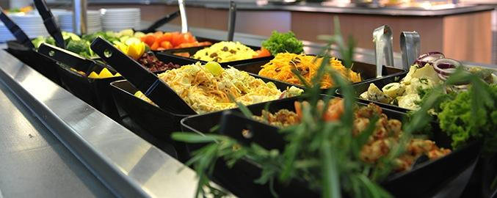
Catering and dietary needs
3 nutritious, balanced meals per day
Self-service salad bar
Vegetarian option
Special diets catered for by prior arrangement
Sample menus available online: www.pgl.co.uk
HOWEVER ON THE DAY WE LEAVE, THE CHILDREN NEED TO HAVE A PACKED LUNCH WITH THEM AS OUR FIRST MEAL IS IN THE EVENING
Notes:
11
We continually invest in healthy menus with freshly cooked ingredients obtained from fully traceable audited suppliers
Processed food is avoided and meals meet Local Authority guidelines
There will be hot and cold options available at every meal
At lunch and dinner the buffet includes a salad bar and mixed fruit basket plus hot and cold drinks
Our caterers can deal with most dietary requirements but please ensure the party leader is aware of any dietary requirements well in advance
More food is always available if required

Slide 12
Kit List
Tops – t-shirts; long sleeved t-shirts/shirts; fleece/jumper
Waterproof jacket
Trousers or leggings; jeans; shorts
Underwear and socks
Suitable nightwear
2 pairs of trainers
Water bottle
Hat/cap/sun cream
2 towels
Small rucksack/bag
Bin bag
SLEEPING BAG AND PILLOW
Wash kit
Hand-held fan
(All named please)

Slide 13
Kit List
DO NOT BRING:
Mobile phones!!
Electrical items, including computer games
Jewellery
Aerosols – this includes deodorant

Slide 14
Medication
If your child requires medication during our
residential, this needs to be handed to Miss Brown, the morning that we go, clearly
labelled in its original packaging with your child’s name and the instructions for taking it, in an envelope or plastic bag. Please remember travel sickness pills for the journey home!

Slide 15
Money
There is a small shop on the site so the children may bring a maximum of £10 to spend. This needs to be in a named purse or envelope and handed to Miss Clegg the morning that we leave.

